Slide 1
Introduction to Linear Algebra
GILBERT STRANG
성병문

Slide 2
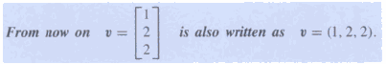
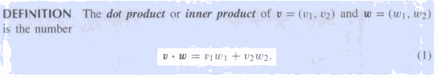
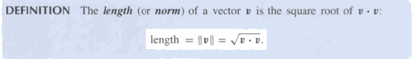
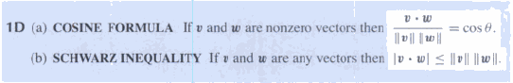
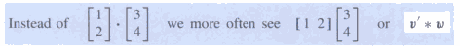
1. Introduction to vectors

Slide 3
2. SOLVING LINEAR EQUATIONS
The row picture shows two lines meeting at a single point.
The column picture combines the column vectors on the left side to produce the vector b on the right side.

Slide 4
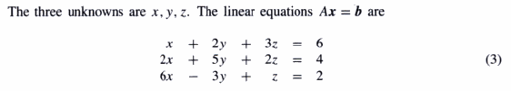
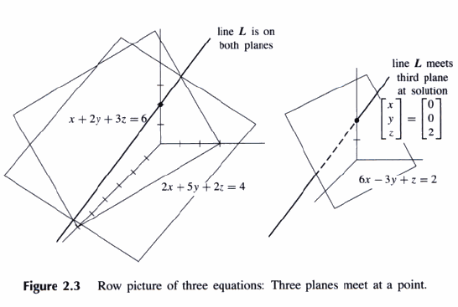
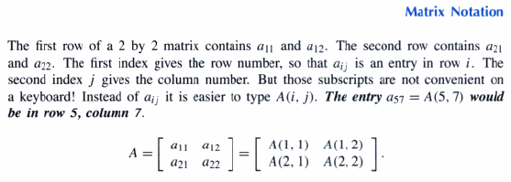

Slide 5
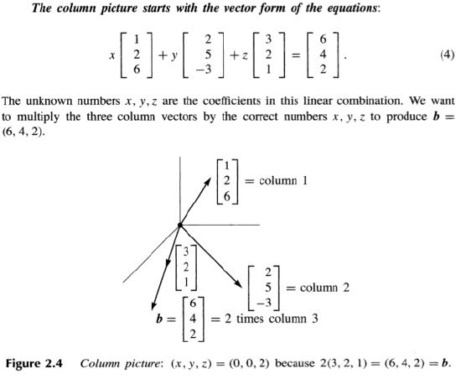
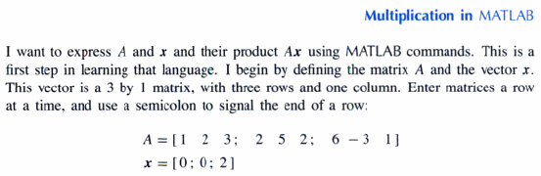

Slide 6
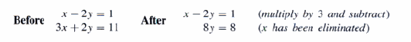
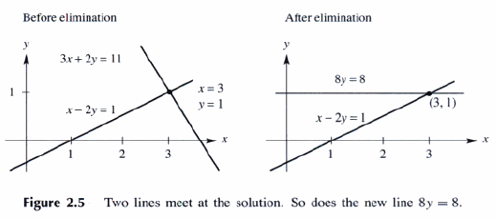
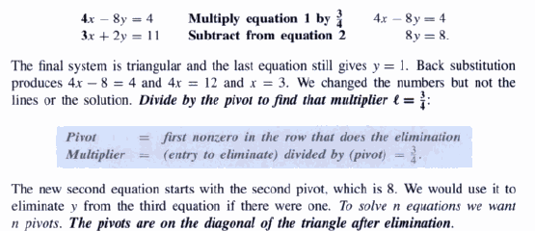
The Idea Of Elimination

Slide 7
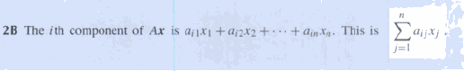
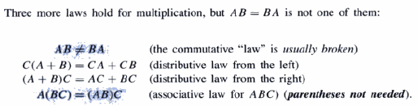
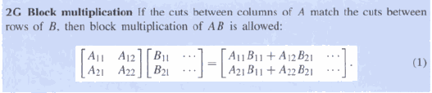

Slide 8
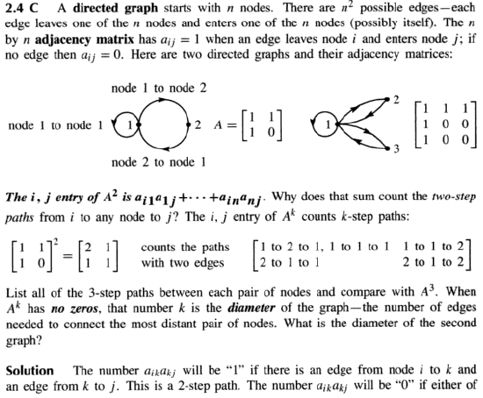
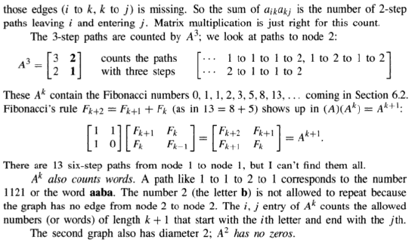

Slide 9
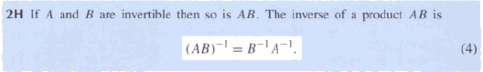
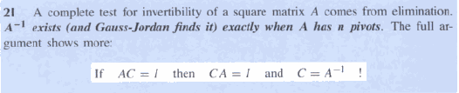
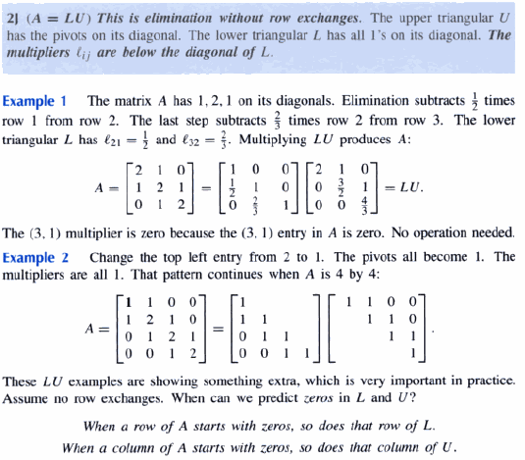

Slide 10
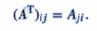
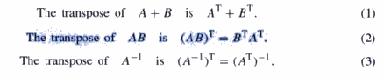
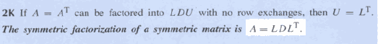

Slide 11
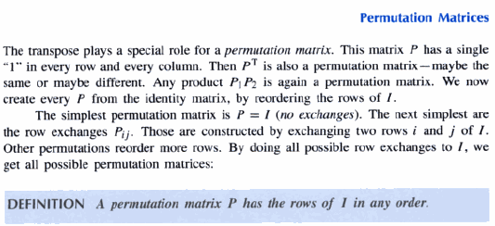
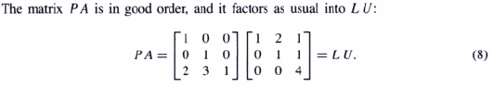
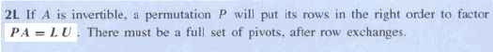

Slide 12
3. VECTOR SPACES AND SUBSPACES
The space ℝ^{n} consists of all column vectors v with n components. A vector whose n components are complex numbers lies in the space ℂ^{n}.
“Inside the vector space” means that the result stays in the space.
A subspace of a vector space is a set of vectors (including 0) that satisfies two requirements: If v and w are vectors in the subspace and c is any scalar, then (i) v + w is in the subspace and (ii) cv is in the subspace.
In other words, the set of vectors is “closed” under addition v + w and multiplication cv. In short, all linear combinations stay in the subspace.
Facts:
Every subspace contains the zero vector.
Line through the origin are also subspace.
A subspace containing v and w must contain all linear combinations cv + dw.

Slide 13
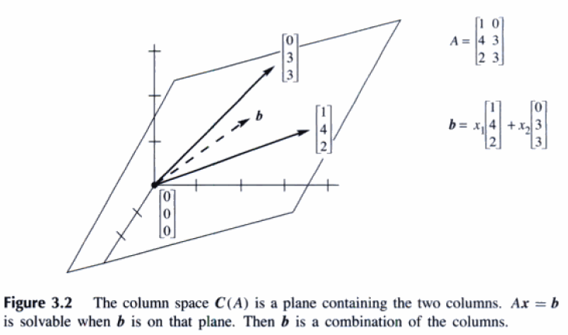
Def. The column space consists of all linear combinations of the columns. The combinations are all possible vectors Ax. They fill the column space C(A).
To solve Ax=b is to express b as a combinations of the columns. The right side b has to be in the column space produced by A on the left side, or no solutions.
3A The system Ax=b is solvable if and only if b is in the column space of A.

Slide 14
THE NULLSPACE OF A: SOLVING AX=0
This section is about the space of solutions to Ax = 0. One immediate solution is x = 0. For invertible matrices this is the only solution. For other matrices, not invertible, there are nonzero solutions to Ax = 0. Each solutions to x belongs to the nullspace of A.
DEF. The nullspace of A consists of all solutions to Ax=0. These solution vectors x are in ℝ^{n}. The nullspace containing all solutions is denoted by N(A).
The solution vectors have n components. They are vectors in ℝ^{n,} so the nullspace is a subset of ℝ^{n}. The column space C(A) is a subspace of ℝ^{m}.
If the right side b is not zero, the solutions of Ax=b do not form a subspace.

Slide 15
THE RANK AND THE ROW REDUCED FORM
The numbers m and n give the size of a matrix – but not necessarily the true size of a linear system. An equation link 0 = 0 should not count. If there are two identical rows in A, the second one disappear in R. Also if row 3 is a combination of rows 1 and 2, then row 3 will become all zeros in R. We don’t want to count rows of zeros. The true size of A is given by its rank:
DEF: The rank of A is the number of pivots. This number is r.
The pivot columns of R have 1’s in the pivots and 0’s every where else.
The pivot columns are not combination of earlier columns. The free columns are combinations of earlier columns. These combinations are the special solutions!

Slide 16
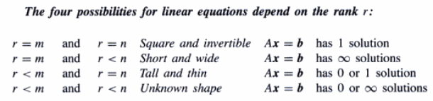
THE COMPLETE SOLUTION TO AX = B
Every matrix A with full column rank (r=n) has all these properties:
All column of A are pivot columns.
There are no free variables or special solutions.
The nullspace N(A) contains only the zero vector x = 0.
If Ax = b has a solution (it might not) then it has only one solution.

Slide 17
INDEPENDENCE, BASIS AND DIMENSION
There are n columns in an m by n matrix, and each column has m components. But the true “dimension” of the column space is not necessarily m or n. The dimension is measured by counting independent columns – and we have to say what that means. We will see that the true dimension of the column space if the rank r.
DEF. The columns of A are linearly independent when the only one solution to Ax=0 is x = 0. No other combination Ax of the columns give the zero vector.
If three vectors are not in the same plane, they are independent.
Independent columns would give full column rank r = n.
The columns of A are independent exactly when the rank is r = n. There are n pivots and no free variables. Only x = 0 is in the nullspace.
Any set of n vectors in R^{m} must be linearly dependent if n > m.

Slide 18
Vectors that Span a Subspace
DEF. A set of vectors spans a space if their linear combinations fill the space.
DEF. The row space of a matrix is the subspace of R^{n} spanned by the rows.

Slide 19
A Basis for a Vector Space
DEF. A basis for a vector is a sequence of vectors that has two properties at once:
1. The vectors are linearly independent.
2. The vectors span the space.
This combination of properties is fundamental to linear algebra. Every vector v is in the space is a combination of the basis vectors, because they span the space. More than that, the combination that produce v is unique, because the basis vectors v₁, …, v_{n} are independent.
The vectors v₁, …, v_{n} are a basis for R^{n} exactly when they are the columns of an n by n invertible matrix. Thus R^{n} has infinitely many different bases.
When any matrix has independent columns, they are a basis for its column space. When the columns are dependent, we keep only the pivot columns-the r columns with pivots. They are independent and they span the column space.
All bases for a vector space contain the same number of vectors. This number is the “dimension” of the space.

Slide 20
Dimension of a Vector Space
There are many choices of the basis vectors, but the number of basis vectors doesn’t change.
3L If v₁, …, v_{n} and w₁, …, w_{m} are both bases for the same vector space, then m = n.
Note about the language of linear algebra. We never say “the rank of a space” of “the dimension of a basis” or “the basis of a matrix”. Those terms have no meaning. It is the dimension of the column space that equals the rank of the matrix.

Slide 21
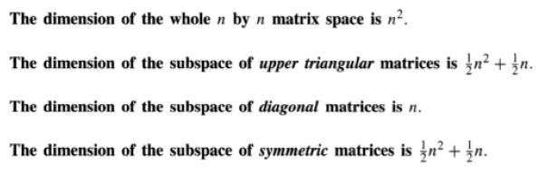
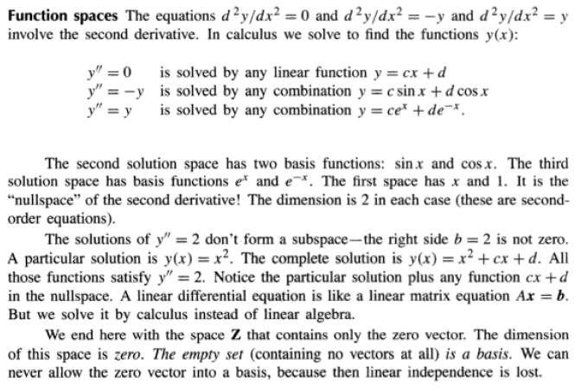

Slide 22
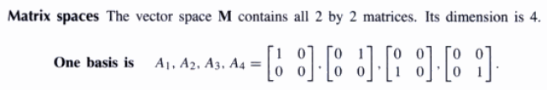
Bases for Matrix Spaces and Function Spaces
The words “independence” and “basis” and “dimension” are not all restricted to column vectors. We can ask whether three 3 by 4 matrices A₁, A₂, A₃ are independent. They are members of the space of all 3 by 4 matrices: some combination might give the zero matrix.
In differential equations, the space of solutions d²y/dx² = y contains functions. One basis is y = e^{x} and y = e^{-x}. Counting the basis functions gives the dimension 2 (for the space all solutions).

Slide 23
We end here with the space Z that contains only the zero vector. The dimension of the space is zero. The empty set (containing no vectors at all) is a basis. We can never allow the zero vector into a basis, because then linear independence is lost.

Slide 24
DIMENSIONS OF THE FOUR SUBSPACES
The rank of a matrix is the number of pivots. The dimension of a subspace is the number of vectors in a basis. The rank of A reveals the dimensions of all four fundamental subspaces.
Four Fundamental Subspaces
1. The row space is C(A^{T}), a subspace of R^{n}.
2. The column space is C(A), a subspace of R^{m}.
3. The nullspace is N(A), a subspace of R^{n}.
1. The left nullspace is N(A^{T}), a subspace of R^{m}. This is our new space.
The matrices A and A^{T} are usually different. So are their column spaces and their nullspaces. But those spaces are connected in an absolutely beautiful way.
The row space and column space have the same dimension r(the rank of the matrix).

Slide 25
4 ORTHOGONALITY

Slide 26
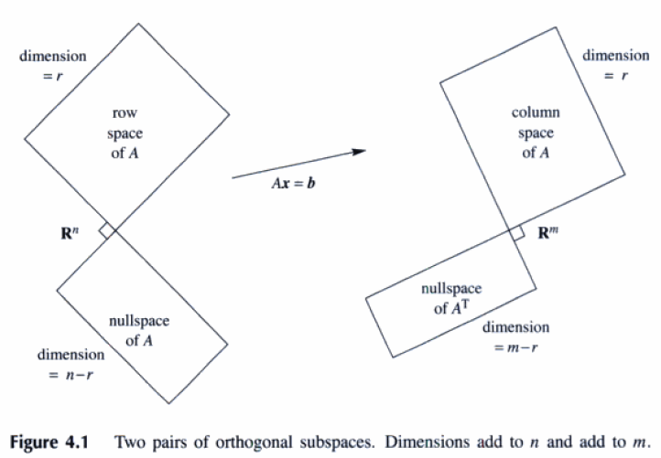
4.1 ORTHOGONALITY OF THE FOUR SUBSPACES
Two vectors are orthogonal when their dot product is zero: v·w = 0 or v^{T}w = 0. This chapter moves up a level, from orthogonal vectors to orthogonal subspaces. Orthogonal means the same as perpendicular.

Slide 27
The row space is perpendicular to the nullspace. Every row of A is perpendicular to every solution of Ax = 0 .
DEF. Two subspace V and W of a vector space are orthogonal if every vector v in V is perpendicular to every vector w in W.
When a vector is in a two orthogonal subspaces, it must be zero. It is perpendicular to itself.
4A Every vector x in the nullspace of A is perpendicular to every row of A, because Ax = 0. The nullspace and row space are orthogonal subspaces.
The vectors in the row space are combinations A^{T}y of the rows. Take the dot product of A^{T}y with any x in the nullspace. These vectors are perpendicular:
x^{T}(A^{T}y) = (Ax)^{T}y = 0^{T}y = 0
4B Every vector y in the nullspace of A^{T} is perpendicular to every column of A. The left nullspace and the column space are orthogonal in R^{m}.

Slide 28
Orthogonal Complements
DEF. The orthogonal complement of V contains every vector that is perpendicular to V. This orthogonal subspace is denoted by V⊥ (pronounced “V perp”).
By this definition, the nullspace is the orthogonal complement of the row space. Every x that is perpendicular to the rows satisfied Ax = 0. N(A)⊥ is exactly the row space C(A^{T}).
Fundamental Theorem of Linear Algebra, Part 2
The nullspace is the orthogonal complement of the row space (in R^{n}).
The left nullspace is the orthogonal complement of the column space (in R^{n}).

Slide 29
Combining Bases from Subspaces
4C Any n linearly independent vectors in R^{n} must span R^{n}. They are a basis. Any n vectors that span R^{n} must independent. They are a basis.
4D If the n columns of A are independent, they span R^{n}. So Ax = b is solvable. If the n columns span R^{n}, they are independent. So Ax = b has only one solution.
Uniqueness implies existence and existence implies uniqueness. Then A is invertible. If there are no free variables (uniqueness), there must be n pivots.

Slide 30
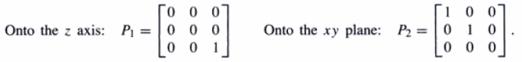
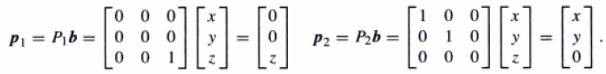
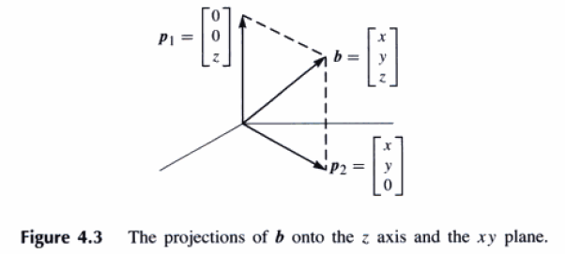
PROJECTIONS
1. What are the projections of b = (2, 3, 4) onto the z axis and the xy plane?
2. What matrices produce those projections onto a line and a plane?
When b is projected onto a line, its projection p is the part of b along that line. If b is projected onto a plane, p is the part in that plane. That projection p is Pb. There is a projection matrix P that multiplies b to give p.

Slide 31
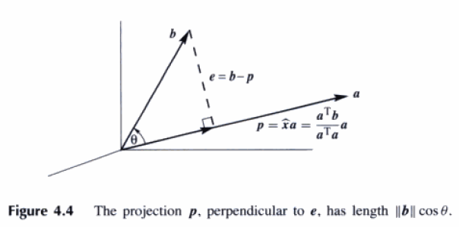
Projection Onto a Line
We are given a line through the origin, in the direction of a = (a₁, …, a_{m}). Along that line, we want the point p closest to b = (b₁, …, b_{m}). The key to projection is orthogonality: The line from b to p is perpendicular to the vector a.
The projection p is some multiple of a. Call it p=xa. The dotted line b – p is b – xa.
a*(b-xa) = 0 or a*b – xa*a = 0 or x=a*b/(a*a) = a^{T}b/(a^{T}a)
p= ax = aa^{T}b/(a^{T}a) = Pb when the matrix is P = aa^{T}/(a^{T}a).
If the matrix is squared, P²=P. Projecting a second time doesn’t change anything, so P²=P.
When P project onto one subspace, I – P projects onto the perpendicular subspace.

Slide 32
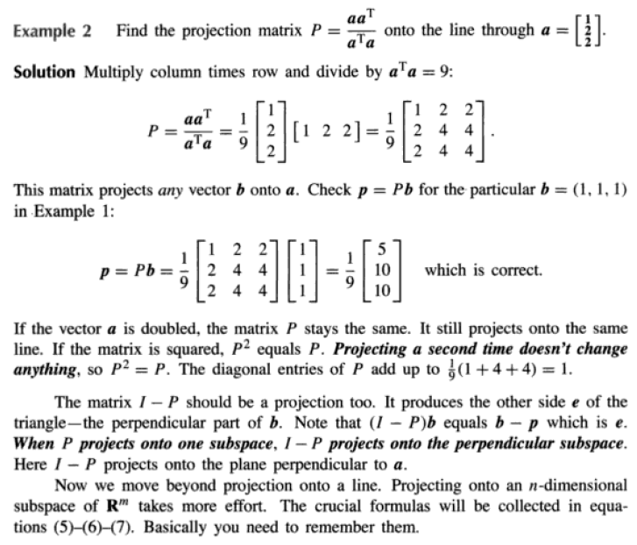

Slide 33
Projection Onto a Subspace
Start with n vectors a₁, …, a_{n} in R^{m}. Assume that these a’s are linearly independent. Problem: Find the combination x₁a₁ + … + x_{n}a_{n} that is closest to a given vector b. We are projecting each b in R^{m} onto the subspace spanned by the a’s.
With n =1 (only one vector a₁) this is projection onto a line. The line is the column space of A, which has just one column. In general the matrix A has n columns a₁, …, a_{n}. Their combination is R^{m} are vectors Ax in the column space. We are looking for the particular combination p = Ax (the projection) that is closest to b. The x indicates the best choice, to give the closest vector in the column space. That choice is a^{T}b/a^{T}b when n = 1. For n > 1, the best x is to be found.

Slide 34
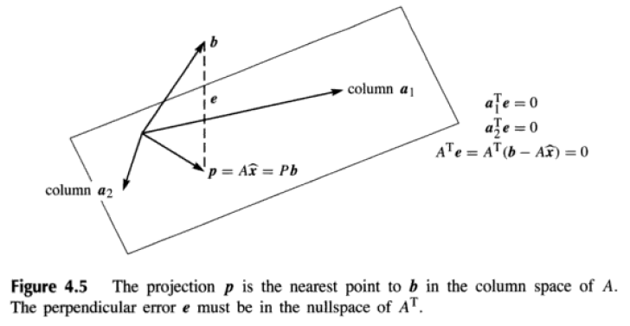
The error vector b – Ax is perpendicular to the subspace. The error b – Ax makes a right angle with all vectors a₁, … a_{n}. That gives the n equations we need to find x:
a₁^{T}(b – Ax) = 0
… or [ a₁ … a_{n} ]^{T}[b – Ax ] = [ 0 ].
a_{n}^{T}(b – Ax) = 0
The n equations are exactly A^{T}(b – Ax) = 0.
A^{T}Ax=A^{T}b.
x = (A^{T}A)⁻¹A^{T}b
p = Ax = A(A^{T}A)⁻¹A^{T}b = Pb
P = A(A^{T}A)⁻¹A^{T}

Slide 35
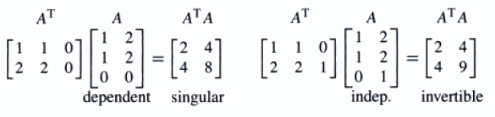
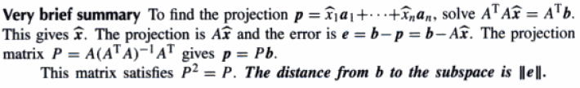
4G ATA is invertible if and only if A has linearly independent columns.
Proof A^{T}A is a square matrix ( n by n). For every matrix A, we will now show that A^{T}A has the same nullspace as A. When the columns of A are linearly independent, its nullspace contains only the zero vector. Then A^{T}A, with this same nullspace, is invertible.
Let A be any matrix. If x is in its nullspace, then Ax = 0. Multiplying by A^{T} gives A^{T}Ax = 0. So x is also in the nullspace of A^{T}A .
(x^{T})A^{T}Ax = 0 or (Ax)^{T}(Ax) = 0 or || Ax ||² = 0
If A has dependent columns, so does A^{T}A. If A has independent columns, so does A^{T}A.
When A has independent columns, A^{T}A is square, symmetric, and invertible.

Slide 36
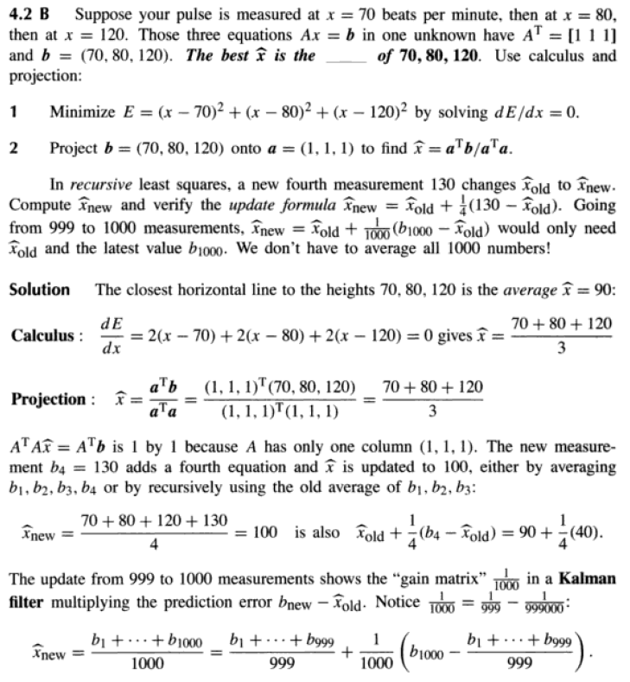

Slide 37
LEAST SQUARES APPROXIMATIONS
It often happens that Ax = b has no solution. The usual reason is: too many equations. The matrix has more rows than columns. There are more equations than unknowns (m is greater than n). The n columns span a small part of m-dimensional space.
We cannot always get the error e = b – Ax down to zero. When e is zero, x is an exact solution to Ax = b. When the length of e is as small as possible, x^ is a least squares solution. Our goal in this section is to computer x^ and use it.
When the original Ax = b has no solution, multiply by A^{T} and solve A^{T}Ax^ = A^{T}b.

Slide 38
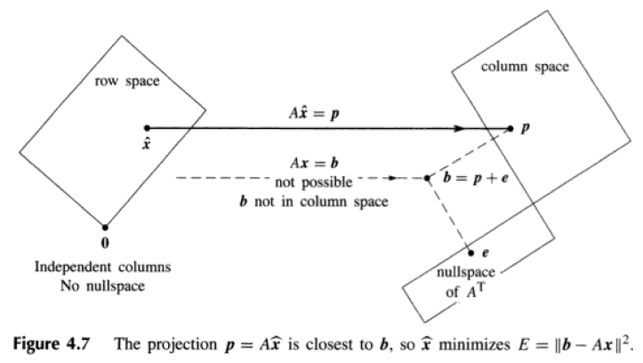
LEAST SQUARES APPROXIMATIONS (2)
The least squares solution x^ makes E = || Ax – b ||² as small as possible.
The partial derivatives of || Ax – b ||² are zero when A^{T}Ax^ = A^{T}b.

Slide 39
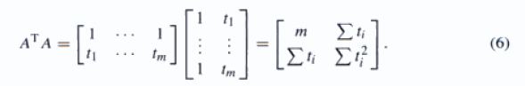
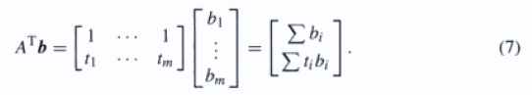
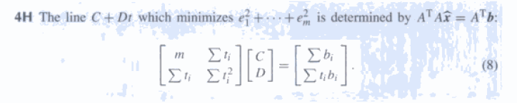
Fitting a Straight Line
The closest line C + Dt has heights p₁, …, p_{m} with errors e₁, …, e_{m}. A^{T}Ax^ = A^{T}b will give x^ = (C, D). The error are e_{i} = b_{i} – C – Dt_{i}.

Slide 40
Fitting a Straight Line (2)
Orthogonal columns are so helpful that it is worth moving the time origin to produce them. To do that, subtract away the average time t^ = (t₁ + … + t_{m})/m. The shifted times T_{i} = t_{i} – t^ add to zero. With the columns now orthogonal, A^{T}A is diagonal. Its entries are m and T₁² + … + T_{m}². The best C and D have direct formulas:
C = (b₁ + … + b_{m})/m
D = (b₁T₁ + … + b_{m}T_{m})/(T₁² + … + T_{m}²)
The best line is C + DT or C + D(t - t^). The time shift that makes ATA diagonal is an example of the Gram-Schmidt process: orthogonalize the columns in advance.

Slide 41
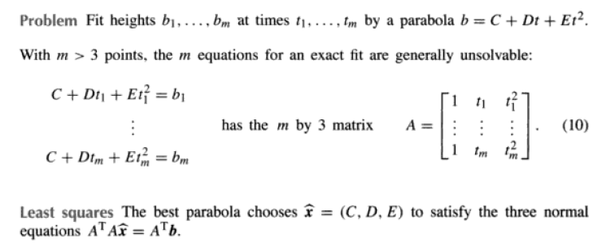
Fitting by a Parabola

Slide 42
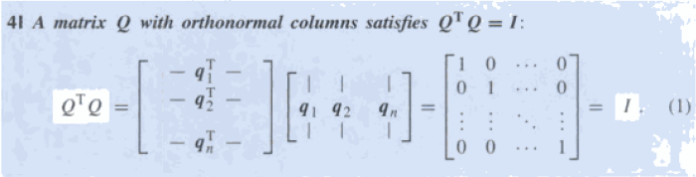
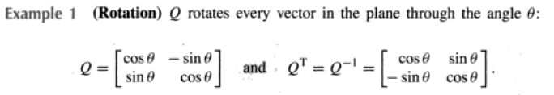
4.4 ORTHOGONAL BASES GRAM-SCHMIDT
This section has tow goals. The first is to see how orthogonality can make calculations simpler. Dot products are zero-so A^{T}A becomes a diagonal matrix. The second goal is to construct orthogonal vectors.
What a basis consists of-independent vectors that span the space. The basis vectors could meet at nay angle (except 0º and 180º).
DEFINITION The vectors q₁, …, q_{n} are orthonormal if q_{i}^{T}q_{j} = 0 when i <> j and q_{i}^{T}q_{j} = 1 when i = j. A matrix with orthonormal columns is assigned the special letter Q.
The matrix Q is easy to work because Q^{T}Q = I. When Q is square, Q^{T}Q = I means that Q^{T} = Q⁻¹: transpose = inverse.

Slide 43
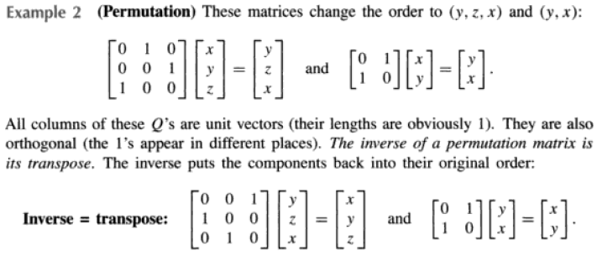


Slide 44




Slide 45


Slide 46

Projecting Using Orthogonal Bases: Q replaces A

Slide 47

Projecting Using Orthogonal Bases: Q replaces A

Slide 48


Slide 49
The Gram-Schmidt Process
Now we find a way to create orthonormal vectors.
Start with three independent vectors a, b, c. We intent to construct three orthogonal vectors A, B, C. Then (at the end is easiest) we divide A, B, C by their lengths. That produces three orthonormal vectors q₁ = A/||A||, q₂ = B/||B||, q₃ = C/||C||.
Gram-Schmidt Begin by choosing A = a. This first direction is accepted. The next direction B must be perpendicular to A. Start with b and subtract its projection along A. This leaves the perpendicular part, which is the orthogonal vector B:
Gram-Schmidt idea B = b – (A^{T}b/A^{T}A)A. (7)
A and B are orthogonal in Figure R.11. Take the dot product with A to verify that A^{T}B = A^{T}b – A^{T}b = 0. This vector B is what we have called the error vector e, perpendicular to A. Notice that B in equation (7) is not zero (otherwise a and b would be dependent). The directions A and B are now set.
The third directions start with c. This is not a combination of A and B (because c is not a combination of a and b). But most likely c is not perpendicular to A and B. So subtract off its components in those two directions to get C:
C = c – (A^{T}c/A^{T}A)A – (B^{T}c/B^{T}B)B. (8)
This is the one and only idea of the Gram-Schmidt process. Subtract from every new vector its projections in the directions already set. That idea is repeated at every step.

Slide 50

The Gram-Schmidt Process (2)

Slide 51

The Factorization A = QR
We started a matrix A, whose columns were a, b, c. We ended with a matrix Q, whose columns are q₁, q₂, q₃. How are those matrices related? Since the vectors a, b, c are combinations of the q’s (and vice versa), there must be a third matrix connecting A to Q. Call it R.
The first step was q₁ = a/||a|| (other vectors not involved). The second step was equation (7), where b is a combination of A and B. At that stage C and q₃ were not involved. This non-involvement of later vectors is the key point of Gram-Schmidt:
The vectors a and A and q1 are all along a single line.
The vectors a, b and A, B and q1, q2 are all in the same plane.
The vectors a, b, c and A, B, C and q1, q2, q3 are in one subspace(dimension 3).
At every step a₁, …, a_{k} are combinations of q₁, …, q_{k}. Later q’s are not involved. The connecting matrix R is triangular, and we have A = QR:
A = QR is Gram-Schmidt in a nutshell.
Multiply by Q^{T} to see why R = Q^{T}A.

Slide 52

The Factorization A = QR (2)
4K (Gram-Schmidt) From independent vectors a₁, .., a_{n}, Gram-Schmidt constructs orthonormal vectors q₁, .., q_{n}. The matrices with these columns satisfy A = QR. The R = Q_{T}A is triangular because later q’s are orthonormal to earlier a’s.
Because of the square roots, QR looks less beautiful than LU. Both factorizations are absolutely central to calculations in linear algebra.

Slide 53
The Factorization A = QR (3)
Any m by n matrix A with independent columns can be factored into QR. The m by n matrix Q has orthonormal columns, and the square matrix R is upper triangular with positive diagonal, We must not forget whey this is useful for least square: A^{T}A equals R^{T}Q^{T}QR = R^{T}R. The least squares equation A^{T}Ax^ = A^{t}b simplifies to
R^{T}Rx^ = R^{T}Q^{T}b or Rx^ = Q^{T}b. (10)
Instead of solving Ax = b, which is impossible, we solve Rx^ = Q^{T}b by back substitution-which is very fast. The real cost is the mn² multiplications in the Gram-Schmidt process, which are needed to construct the orthogonal Q and the triangular R.

Slide 54


Slide 55


Slide 56
5 DETERMINANTS The PROPERTIES OF DETERMINANTS
The determinant of a square matrix is a single number. That number contains an amazing amount of information about the matrix. It tells immediately whether the matrix is invertible. The determinant is zero when the matrix has no inverse. When A is invertible, the determinant of A⁻¹ is 1/(det A).
The product of the pivots is the determinant.
The determinant changes sign when two rows (or two columns) are exchanged.
The identity matrix has determinant +1.
The other essential rule is linearity – but a warning comes first. Linearity does not mean that det( A + B ) = det A + det B. This is absolutely false. The true rule is det( 2I ) = 2^{n}. Determinant are multiplied by 2^{n} (not just by 2) when matrices are multiplied by 2.

Slide 57


We don’t intend to define the determinant by its formulas. It is better to start with its properties– sign reversal an linearity.
Determinant give A⁻¹ and A⁻¹b.
When the edges of a box are the rows of A, the volume is |det A|.
The numbers λ for which A – λI is singular and det(A – λI) = 0 are the eigenvalues of A.
The determinant is a linear function of each row separately (all other rows stay fixed). If the first row is multiplied by t, the determinant is multiplied byt. If first rows are added, determinants are added.

Slide 58
If two rows of A are equal, then det A = 0.
Subtracting a multiple of one row from another row leaves det A unchanged.
A matrix with a row of zeros has det A = 0.
If A is triangular then det A = a₁₁a₂₂…a_{nn} = product of diagonal entries.
If A is singular then det A = 0. If A is invertible then det A is not zero.
The determinant of AB is det A times det B.
The transpose A^{T} has the same determinant as A.

Slide 59



PERMUTATIONS AND COFACTORS

Slide 60

Determinant by Cofactors

Slide 61


CRAMER’S RULE, INVERSES, AND VOLUMES

Slide 62


Slide 63



Slide 64

Area of a Triangle

Slide 65


Slide 66

Triple Product = Determinant = Volume
Since uxv is a vector, we can take its dot product with a third vector w. That produces the triple product (uxv)*w. It is called a “scalar” triple product, because it is a number.

Slide 67
6 EIGENVALUES AND EIGENVECTORS
Eigenvalues have their greatest importance in dynamic problems. Those eigenvalues are a new way to see into the heart of a matrix.

Slide 68
The Equation for the Eigenvalues
Ax = λx
(A – λI) x = 0
The eigenvectors x make up the nullspace of A – λI.
If (A – λI) x = 0 has a nonzero solution, A – λI is not invertible. The determinant of A – λI must be zero.
The number λ is an eigenvalue of A if and only if A – λI is singular. det( A – λI ) = 0.
If you add a row of A to another row, or exchange rows, the eigenvalues usually change. Elimination does not preserver the λ’s.
The product λ₁ times λ₂ and the sum λ₁ + λ₂ can be found quickly from the matrix.
The product of the n eigenvalues equals the determinant of A.
The sum of the n eigenvalues equals the sum of the n diagonal entries of A. This sum along the main diagonal is the trace of A;
λ₁ + …. + λ_{n} = trace = a₁₁ + …. + a_{nn}.

Slide 69
Imaginary Eigenvalues
The eigenvalues might not be real numbers.

Slide 70
DIAGONALIZING A MATRIX
The matrix A turns into a diagonal matrix A when we use the eigenvectors properly. This is the matrix form of our key idea.
6D Diagonalization Suppose the n by n matrix A has n linearly independent eigenvectors x₁, …, x_{n}. Put them into the columns of an eigenvector matrix S. Then S⁻¹AS is the eigenvalue matrix Λ:
S-1AS = Λ = [λ₁ ….; …. ; … λ_{n} ]

